Slide 1
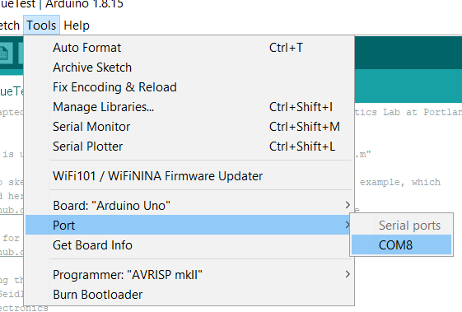
KneeTest.m
Used with KneeTorqueTest.ino and SLoadCell_ZeroFactorSketch.ino
With KneeTorqueTest, Run command like this:
Opens valve and reads pressure and force data
Protocol id (1 for zeroing the load cell, 2 for knee torque test)
The number of data points to collect
Port that the arduino is connected to (the number after the COM as seen in the example)

Slide 2
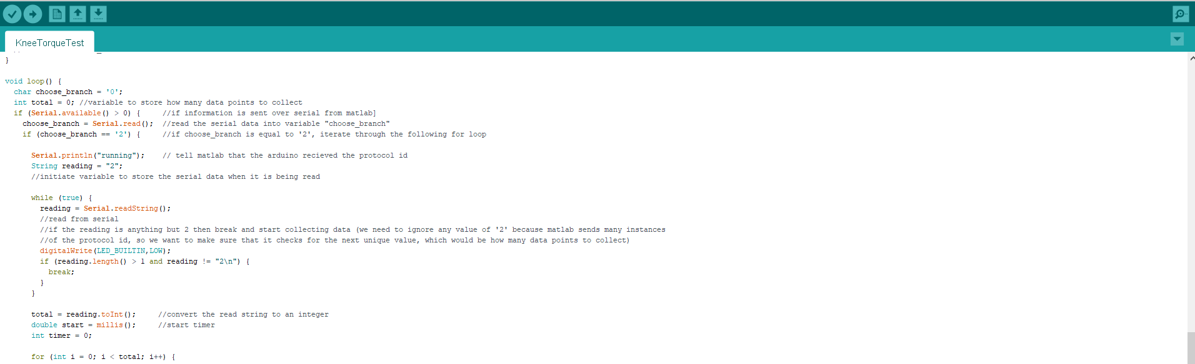
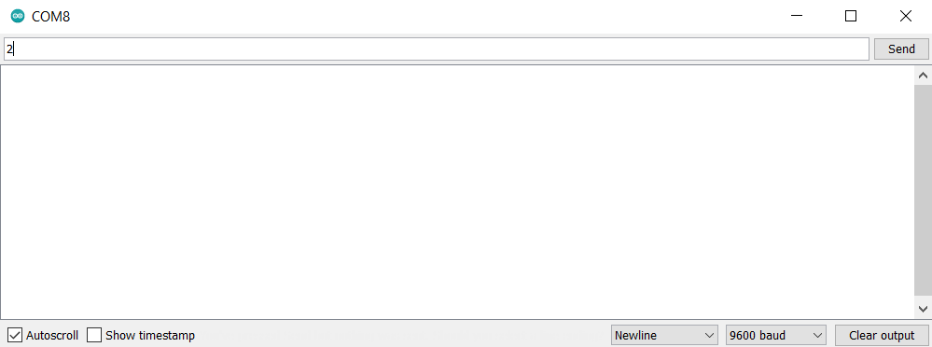
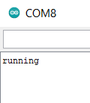
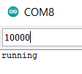

KneeTorqueTest.ino
A
Used with KneeTest.m
To use without KneeTest.m:
Open serial monitor inside arduino
Send “2” until “running” is received
Send number for how many data points to collect
The arduino will start sending the data and open the valve
B
C
D

Slide 3
ValvePWM.m
Used with ValvePWM.ino
Split into two phases: inflating and deflating
Run command like this:
Protocol id (2 for pwm test)
Port of arduino board (COM4 in this example)
Amount of data points to be inflating
Amount of data points to be deflating
Pulse width while inflating
Period while inflating
Pulse width while deflating
Period while deflating

Slide 4
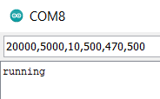
ValvePWM.ino
Used with ValvePWM.m
To use without ValvePWM.m
Open Serial Monitor
Send “2” until “running” is received
Send values for data_in, data_out, pw_in, period_in, pw_out, and period_out in that order, separated by commas

Slide 5
PressureTest.m
Used for leak/fill test with PressureTest.ino
Operated in the same way as KneeTest.m
Only reports pressure

Slide 6
PressureTest.ino
Used for leak/fill test with PressureTest.m
Operated in the same way as KneeTorqueTest.ino
Only reports pressure

Slide 7
Knee Joint
BPA
Physical Connection
Air
Air
Pressurized Air
Valves
Physical Connection
Pressure Sensor
Air
Load Cell
Data
Data
Amp
Data
Microcontroller
Transistors
Negative
On/Off
24V
Ground
Power Supply
Knee Test

Slide 8
BPA
Physical Connection
Air
Air
Pressurized Air
Valves
Pressure Sensor
Air
Load Cell
Data
Data
Amp
Data
Microcontroller
Transistors
Negative
On/Off
24V
Ground
Power Supply
BPA characterization

Slide 9
BPA
Air
Air
Pressurized Air
Valves
Pressure Sensor
Air
Data
Microcontroller
Transistors
Negative
On/Off
24V
Ground
Power Supply
Leak/fill test

Slide 10
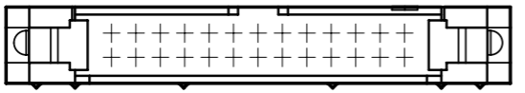
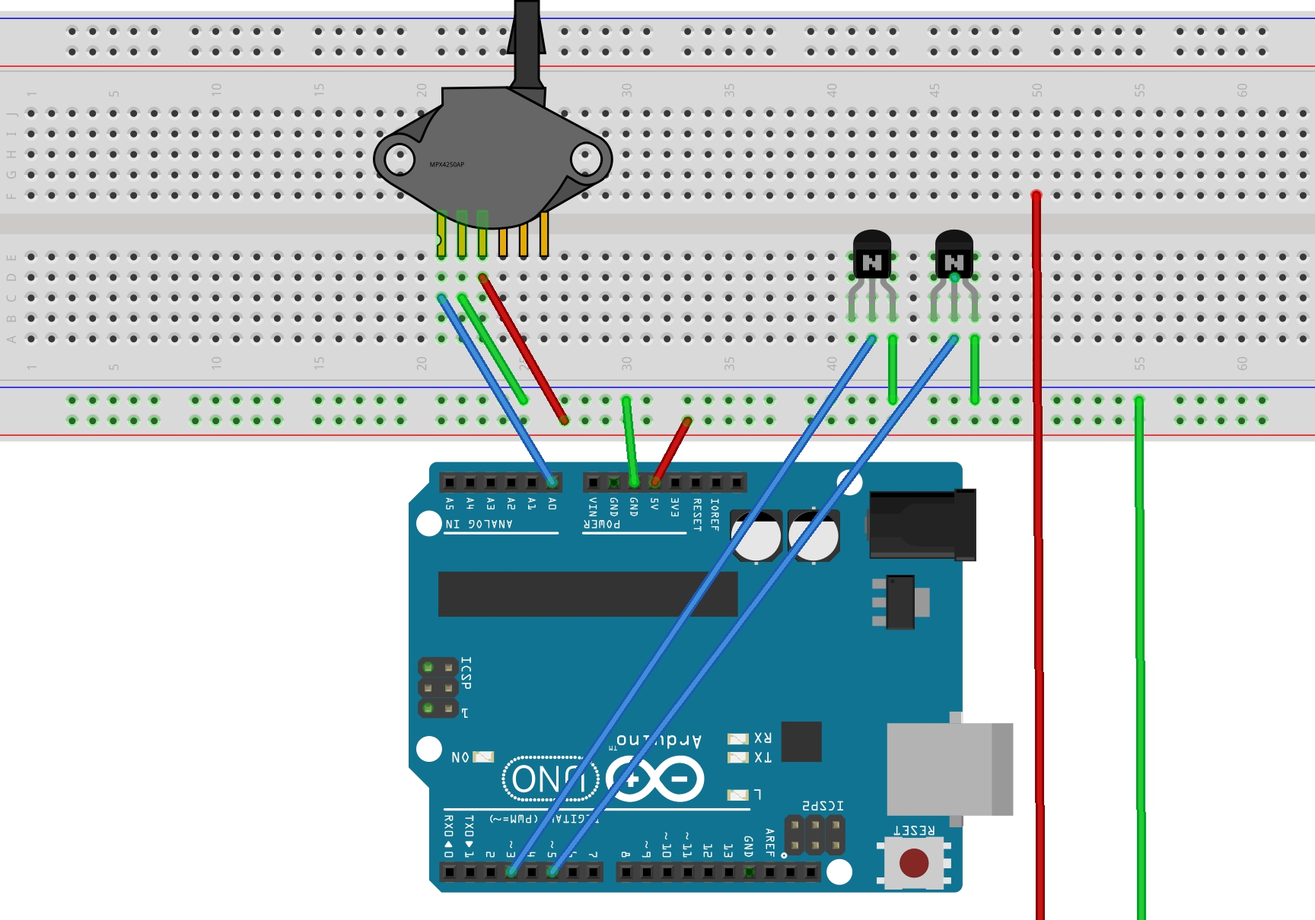
24v
24v
GND

